Slide 1
Pattern Matching with
Acceleration Data
Pramod Vemulapalli

Slide 2
Outline
50 % Tutorial and 50 % Research Results
  Basics
  Literature Survey
Acceleration Data
  Preliminary Results
  Conclusions

Slide 3
What is A Time-Series Subsequence ?
Time Series
Time Series Subsequence

Slide 4



What is Time-series
Subsequence Matching?
Given a Query Signal
Find the most
“appropriate”
match in a database

Slide 5
Applications for TSSM
Data Analytics
  Scientific Data
  Financial Data
  Audio Data (Shazham on Iphone)
  SETI Data
  A lot of Time Series Data in this universe and in similar parallel universes …
Every time you ask questions such as these :
  When is the last time I saw data like this ?
  Is there any other data like this ?
  Is this pattern a rarity or something that occurs frequently ?

Slide 6
Brute Force
Sliding Window Method
Extract a
Signal
Compare With
Template
Store the
Distance
Metric
(Euclidean)
All metrics within a certain threshold indicate the results
…. | 52.3 | 12.3 | 10.3 | …..

Slide 7
History
Faloutsos 1994
  Indexing
  Preprocessing
Database
Extract a
Signal
Fourier Transform
11.3 | 9.0 | 6.0
12.3 | 10.0 | 11.0
2.3 | 1.0 | 9.0
Fourier Transform
10.0 | 9.5 | 60

Slide 8
History
Faloutsos 1994
  Matching
  Post Processing
    Find matches from above process and check for Euclidean distance criterion of the entire signal
Database
11.3 | 9.0 | 6.0
10.0 | 9.5 | 60
12.3 | 10.0 | 11.0
2.3 | 1.0 | 9.0
From Parseval’s theorem, if Euclidean distance between these coefficients exceeds given threshold , then euclidean distance between original signal is greater than the threshold

Slide 9
Subsequent Work
A number of subsequent papers followed this model
  Discrete Fourier Transform 1994⁽¹⁾
  Singular Value Decomposition 1994⁽¹⁾
  Discrete Cosine Transform 1997⁽²⁾
  Discrete Wavelet Transform 1999⁽³⁾
  Piecewise Aggregate Approximation 2001⁽⁴⁾
  Locally Adaptive Piecewise Approximation 2001⁽⁵⁾
1) C. Faloutsos, M. Ranganathan, and Y. Manolopoulos. Fast Subsequence Matching in Time-Series Databases. In SIGMOD Conference, 1994.
2) F. Korn, H. V. Jagadish, and C. Faloutsos. Efficiently supporting ad hoc queries in large datasets of time sequences. In SIGMOD 1997
3) K. pong Chan and A. W.-C. Fu. Efficient Time Series Matching by Wavelets. In ICDE, 1999.
4) E. J. Keogh, K. Chakrabarti, S. Mehrotra, and M. J.Pazzani. Locally Adaptive Dimensionality Reductionfor Indexing Large Time Series Databases. In SIGMOD Conference, 2001.
5) E. J. Keogh, K. Chakrabarti, M. J. Pazzani, and S. Mehrotra. Dimensionality Reduction for Fast Similarity Search in Large Time Series Databases. Knowl. Inf. Syst., 3(3), 2001.

Slide 10
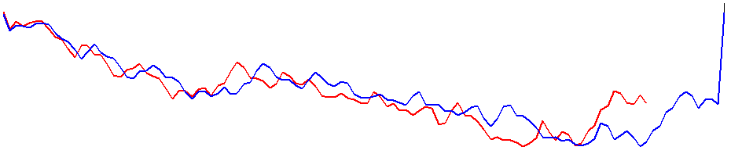
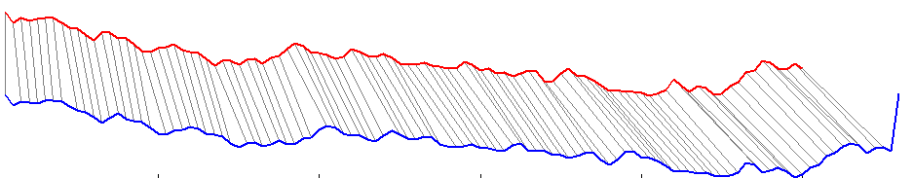
Drawbacks: Euclidean Distance Metric
Not robust to temporal distortion
Not robust to outliers
Example :
Something that can account for temporal distortion

Slide 11
DTW based Matching
Previous Work
  Dynamic Time Warping 1994 ⁽¹⁾
  . . . .
  Longest Common Subsequence 2002⁽²⁾
  Edit Distance Based Penalty 2004⁽³⁾
  Edit Distance on Real Sequence 2005⁽⁴⁾
  Exact Indexing of Dynamic Time Warping 2004⁽⁵⁾
1) D. J. Berndt and J. Clifford. Using dynamic time warping to find patterns in time series. In KDD
Workshop, 1994.
2) M. Vlachos, D. Gunopulos, and G. Kollios. Discovering similar multidimensional trajectories. In ICDE, 2002.
3) L. Chen and R. T. Ng. On the marriage of lp-norms and edit distance. In VLDB, 2004.
4) L. Chen, M. T. ¨Ozsu, and V. Oria. Robust and fast similarity search for moving object trajectories. In
SIGMOD Conference, 2005.
5) Eamonn Keogh and Chotirat Ann Ratanamahatana. Exact Indexing of Dynamic Time Warping. Knowledge and Information Systems: An International Journal (KAIS). DOI 10.1007/s10115-004-0154-9. May 2004.

Slide 12
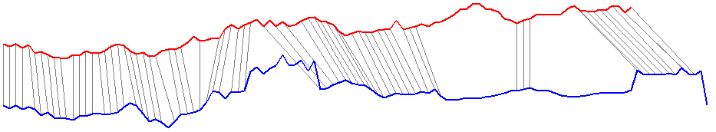
Drawbacks: Dynamic Time Warping
Performs Amplitude Matching: Not robust to amplitude distortion
Computationally expensive (especially for longer query signals )

Slide 13
Recent Trends (Hard to predict)
Local Patterns for Matching (Robust to Amplitude and Temporal Distortion)
  Landmarks 2000(Smooth a signal and break it at its extrema) ⁽¹⁾
  Perceptually Important Points (Sliding Window of Different Sizes) 2007⁽²⁾
  Spade 2007 (Break a time signal into smaller pieces) ⁽³⁾
  Shapelets 2010 (Sliding Window of Different Sizes)⁽⁴⁾
Landmarks: A New Model for Similarity-Based Pattern Querying in Time Series Databases, Proceedings of the 16th International Conference on Data Engineering, p.33, February 28-March 03, 2000
T.C. Fu, F.L. Chung, R. Luk and C.M. Ng, Stock time series pattern matching: template-based vs. rule-based approaches, Engineering Applications of Artificial Intelligence 20 (3) (2007), pp. 347–364
Y. Chen, M. A. Nascimento, B. C. Ooi, and A. K. H. Tung. SpADe: On Shape-based Pattern Detection in Streaming Time Series. In ICDE, 2007.
Ye, Lexiang, and Keogh, Eamonn. Time series shapelets: a novel technique that allows accurate, interpretable and fast classification , Data Mining and Knowledge Discovery 2010.

Slide 14
Drawbacks of Current Methods
(Brute Force) ^ 2
  Extract local patterns and perform usual matching
  Has only been used for small datasets for specific data mining problems
  Something that captures the robustness of local patterns and doesnot use the traditional sliding window methods for matching
Redundant Matching
  Larger sized patterns also contain smaller sized patterns
  Something that tries to isolate information content in different bands and matches the information content in each band.

Slide 15
Acceleration Data

Slide 16
Acceleration Data
A large amount of vehicle data has been collected.
  Acceleration Data
  Vehicle Service Records
  No GPS data !
Some of these vehicles were in convoys and some were independent
Problem: Group the vehicles based on acceleration data to perform other data mining tasks
  Vehicles that travelled in convoys or on the same roads must have similar acceleration

Slide 17
Same Road = Same Acceleration ?
Acceleration Data
  Route
  Driver Behavior
  Traffic Conditions
Has a consistent effect
?
?

Slide 18
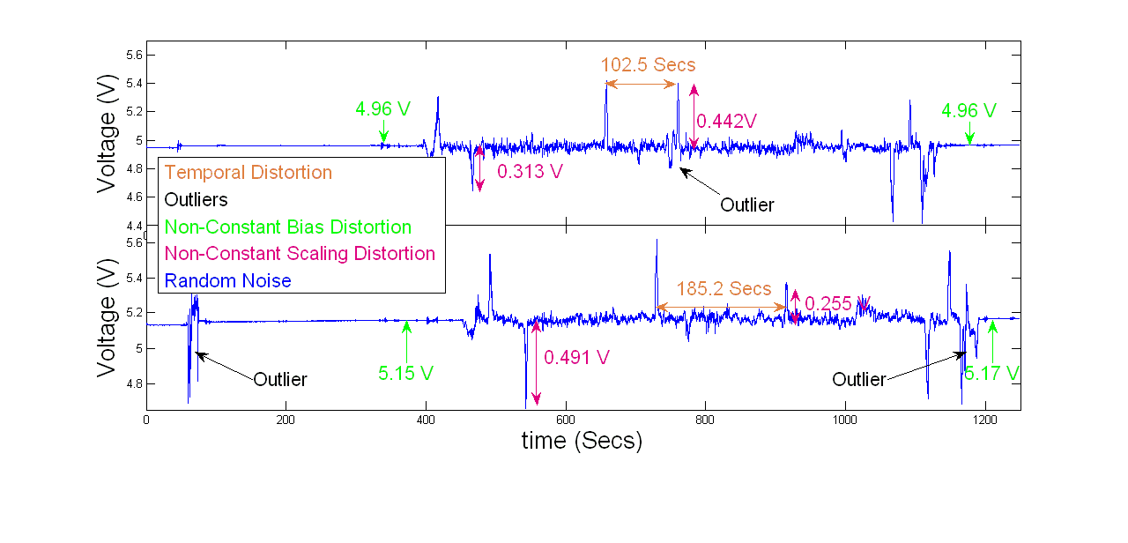
Same Road = Same Acceleration ?
Acceleration Data
  Route
  Driver Behavior
  Traffic Conditions
Constant
Variable
Variable

Slide 19
Which time series subsequence matching technique to use ?
Local pattern matching : Robust to Amplitude and Temporal Distortion
Very memory intensive especially for large query sets
  Avoid Sliding Window
Very computationally intensive
  Isolate Information Content

Slide 20
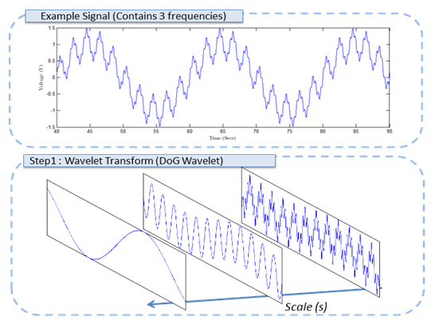
Isolate Information Content ?
Take a wavelet transform
  Obtain dyadic frequency band
    Better frequency resolution at lower frequencies
    Better time resolution at higher frequencies

Slide 21
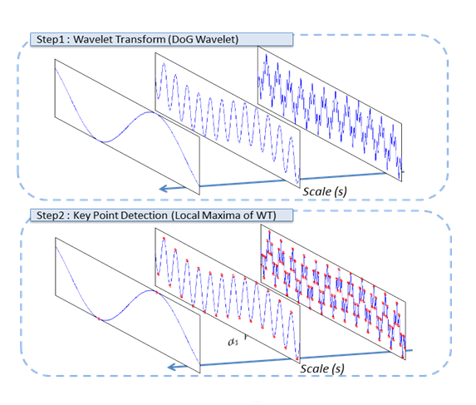
Avoid Sliding Window?
Take a wavelet transform
  Take Wavelet Maxima
  Maxima can be used to completely reconstruct the signal
  Maxima are a stable and unique representation of a signal
  Avoid sliding window by just trying to match the wavelet maxima from signals
1) Mallat, S., A Wavelet Tour of Signal Processing. New York : Academic, 1999.
2) S.Zhong, S.Mallat and., "Characterization of signals from multiscale edges ." 1992, Issue IEEE Transactions on Pattern Analysis and Machine Intelligence .
3) C.J.Lennard, C.J.Kicey and., "Unique reconstruction of band-limited signals by a Mallat-Zhong Wavelet Transform ." s.l. : Birkhäuser Boston, 1997, Issue Journal of Fourier Analysis and Applications.

Slide 22
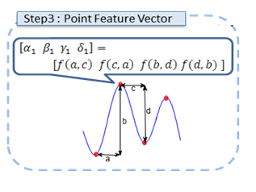
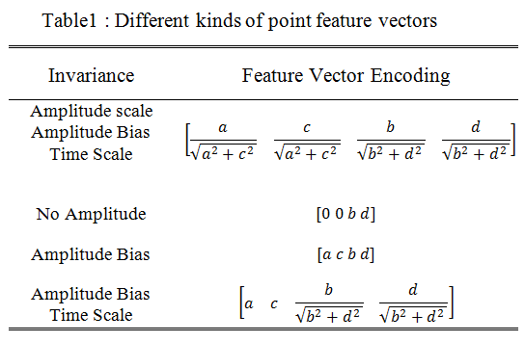
Compare Wavelet Maxima ?
  Create feature vector that encodes relative distances of the maxima
    Common vision technique
  Encode the distance by incorporating the necessary invariance
  More Invariance =>
    More robust to noise
    Less unique for matching
  Increase Uniqueness by encoding many points
    Lesser robustness to outliers

Slide 23
Multi Scale Extrema Features
Matching Process
1.2 | 2.3 | 3.5 | 2.0
1.4 | 2.5 | 2.0 | 2.2
3.6 | 3.2 | 3.5 | 2.2
1.0 | -5 | -2 | 1.2
3.6 | 2.5 | 3.3 | 3.6
1.4 | 2.5 | 2.0 | 2.2
3.6 | 3.2 | 3.5 | 2.2
1.0 | -5 | -2 | 1.2

Slide 24
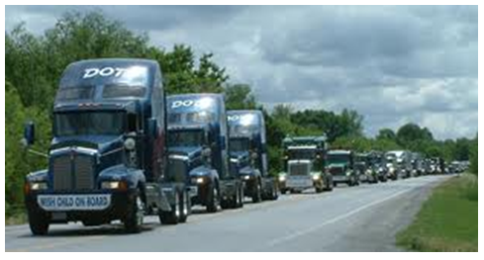
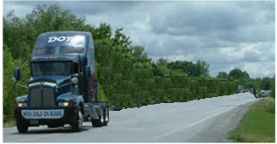
Preliminary Test: Find most appropriate feature for acceleration data
  Collect data in convoy formation
  Use data from one of the vehicles to create database
  Data from other vehicles is used as Query Data
  Non Convoy Case
  Use this data as query data
  GPS data is used as position reference in both cases

Slide 25
Results:

Slide 26
Results:

Slide 27
Results

Slide 28
Results

Slide 29
Conclusions & Future Work
Multiscale Extrema Features work better with Non-Convoy Data
Euclidean distance measure works well with convoy data for short query lengths
Analyze the performance of DTW methods
Use different feature encoding methods
  Go beyond neighboring points
Advantages with respect to short time series clustering

